Slide 1

SP CAFÉ CSQUARE PVT LTD

Slide 2
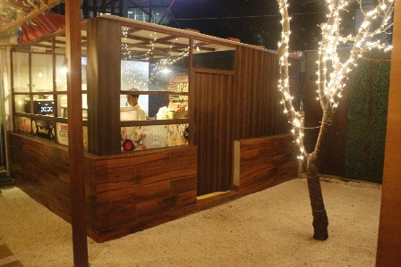



Slide 3
I
N
T
R
O
D
U
C
T
I
O
N
Concept CSQUARE was established in 2016 by Mr. Supraneet Khanna a well known name in the Indian Retail and Indian Food Industry
The concept is driven for getting the experience enrich in café and bar with diversity of cuisine under one roof.
Our cuisine is Indian, continental, Italian, Chinese, Mediterranean, Arabic, etc.
The team on board consist of professionals from the food industry to assure the best quality food.
Mr. Supraneet’s Vision is to deliver the best quality and pocket friendly dishes and food products.

Slide 4
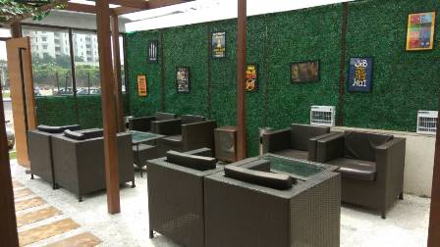
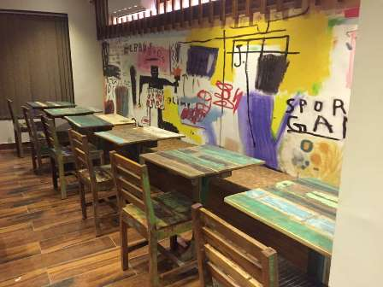
OUTDOOR
SEATING
INDOOR
SEATING

Slide 5
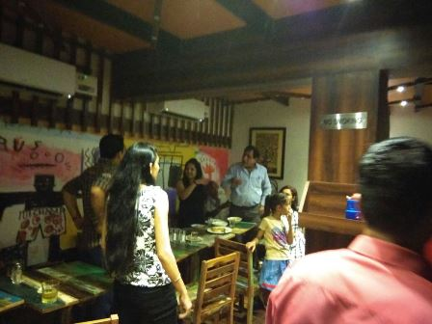
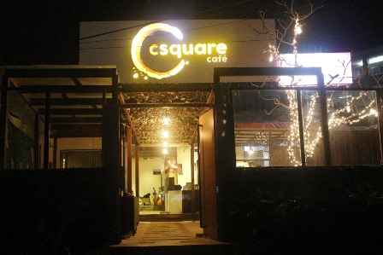
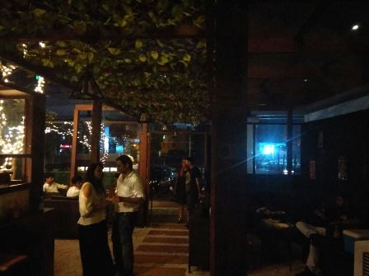
Best Place for Family & Friends to Chill

Slide 6



Target Audience In Cafe
Families , Teenagers , Office Workers ,Youth Etc.
Corporates, busy street low maintenance markets, university/school areas and canteens in hospitals etc.

Slide 7
Industry Requirements
Proper & Required Ambience
Quality Food
Quality Time Spending Space with Family & Friends
Official Meetings / Parties / Presentation
Need Proper Entertainment Facilities.
Friendly Environment / Staff.
Creative Ambience
With Combination of Games / Music / Books
With Music Instruments / Live Plays.

Slide 8

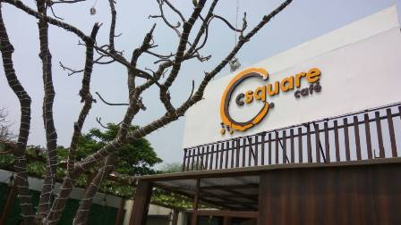








Slide 9
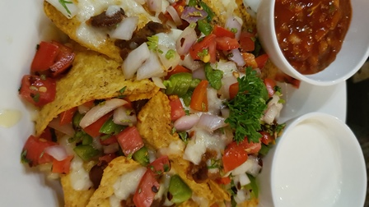
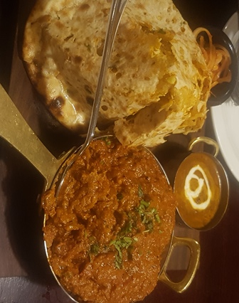
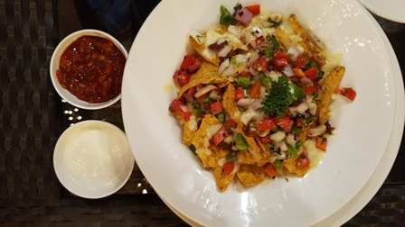
OUR FOOD GALLERY

Slide 10

Thank you ☺

